Slide 1
“Parts of Essay”
English Composition & Comprehension
Department of Computer Science

Slide 2
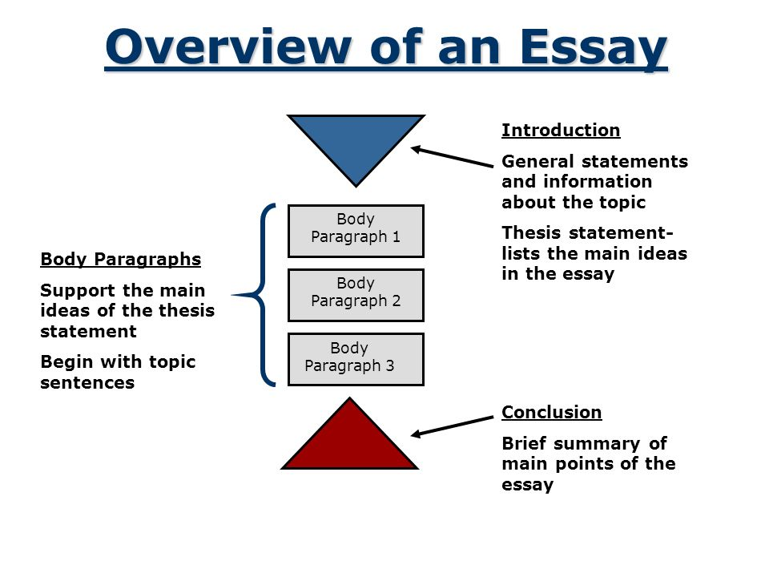

Slide 3
Parts of Essay
An essay is only as good as its introduction. An introduction must be followed by a number of pieces of evidence (the ‘body of the essay’). The evidence must lead to conclusion.
Introduction
Body
Conclusion

Slide 4
Introduction
Its important to get the opening statement right. It can be achieved by including:
What you are going to write about
Which sources you will call upon to support your argument
A brief statement of what you hope to demonstrate
A METAPHOR FOR INTRODUCTION:
Pull the rabbit out of the hat right at the beginning
Show your reader the rabbit so you can spend the rest of the essay describing your ‘common burrowing rodent’.

Slide 5
THINK ABOUT YOUR READER
There is nothing more frustrating than trying to understand why this or that has been mentioned in the essay without first knowing where the argument is going.
You would not buy a car or a computer without first finding out about its specifications. You need to know what it can do before you shell out your hard-earned cash.
Imagine the introduction is the advertising brochure for your essay. In it you must give all the information that will help your reader buy your argument.
The brochure, like the introduction, is not the argument itself, but must say what the argument is going to be, and why it is a good argument. The introduction must say why the argument is worth believing.

Slide 6
Body of the Essay
If you have written a good introduction, the main part of your essay will not be so hard. It will fill in the details of the brochure you laid out in the introduction.
WHAT SHOULD EACH PARAGRAH CONTAIN
Present some evidence
Say where the evidence came from (context)
Say why that evidence is part of this argument (comment)
WHAT IS EVIDENCE?
Quotation from a book
Data from an experiment
Observation of some other type

Slide 7
Conclusion
Restates that the preceding argument is valid
Repeats the introduction in a brief way

